Slide 1
Dynamic Sea Beach View
GROUP :D
Shourav, Tanvir Tanjum (17-35860-3)
Limon, Zishad Hossain (18-36101-1)
Chowdhury, Ashfaq Afzal (17-35800-3)
Tina, Anika Tahsin (17-35852-3)

Slide 2
Features
It will contain a beautiful sea side view.
There will be some different scene: Day, Night and Evening along with rain effect.
Each effect will contain sound in background. e.g. Rain and sea wave.
Rain effect will appear/disappears by button press.
During rain effect birds and balloon will disappear.
Synchronized object animation e.g. Sun and Moon.
Moving objects e.g. Sun, Moon, Balloon, Ships, Clouds, Birds and sea wave.

Slide 3
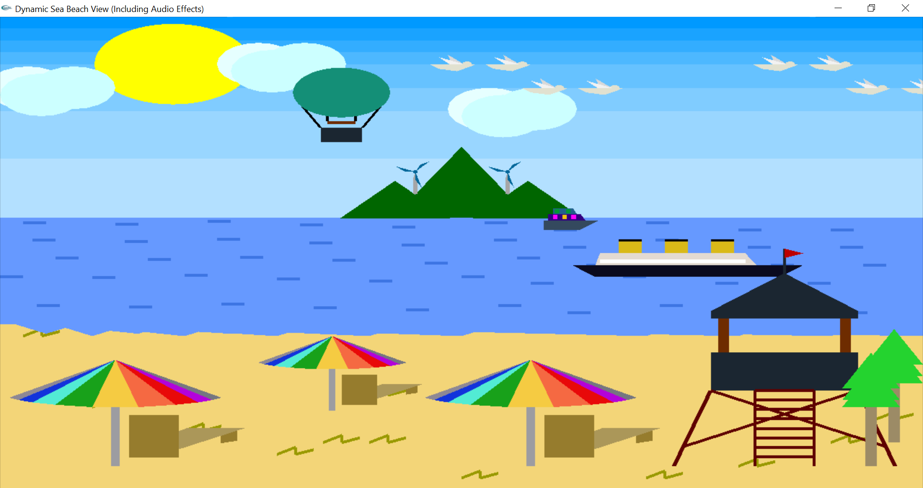
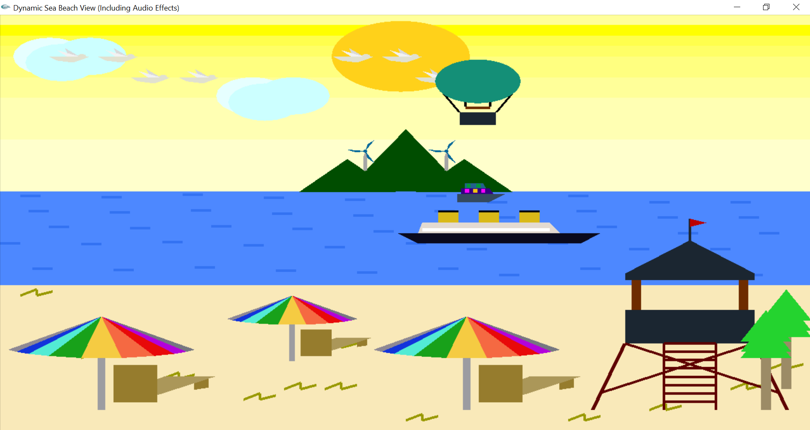
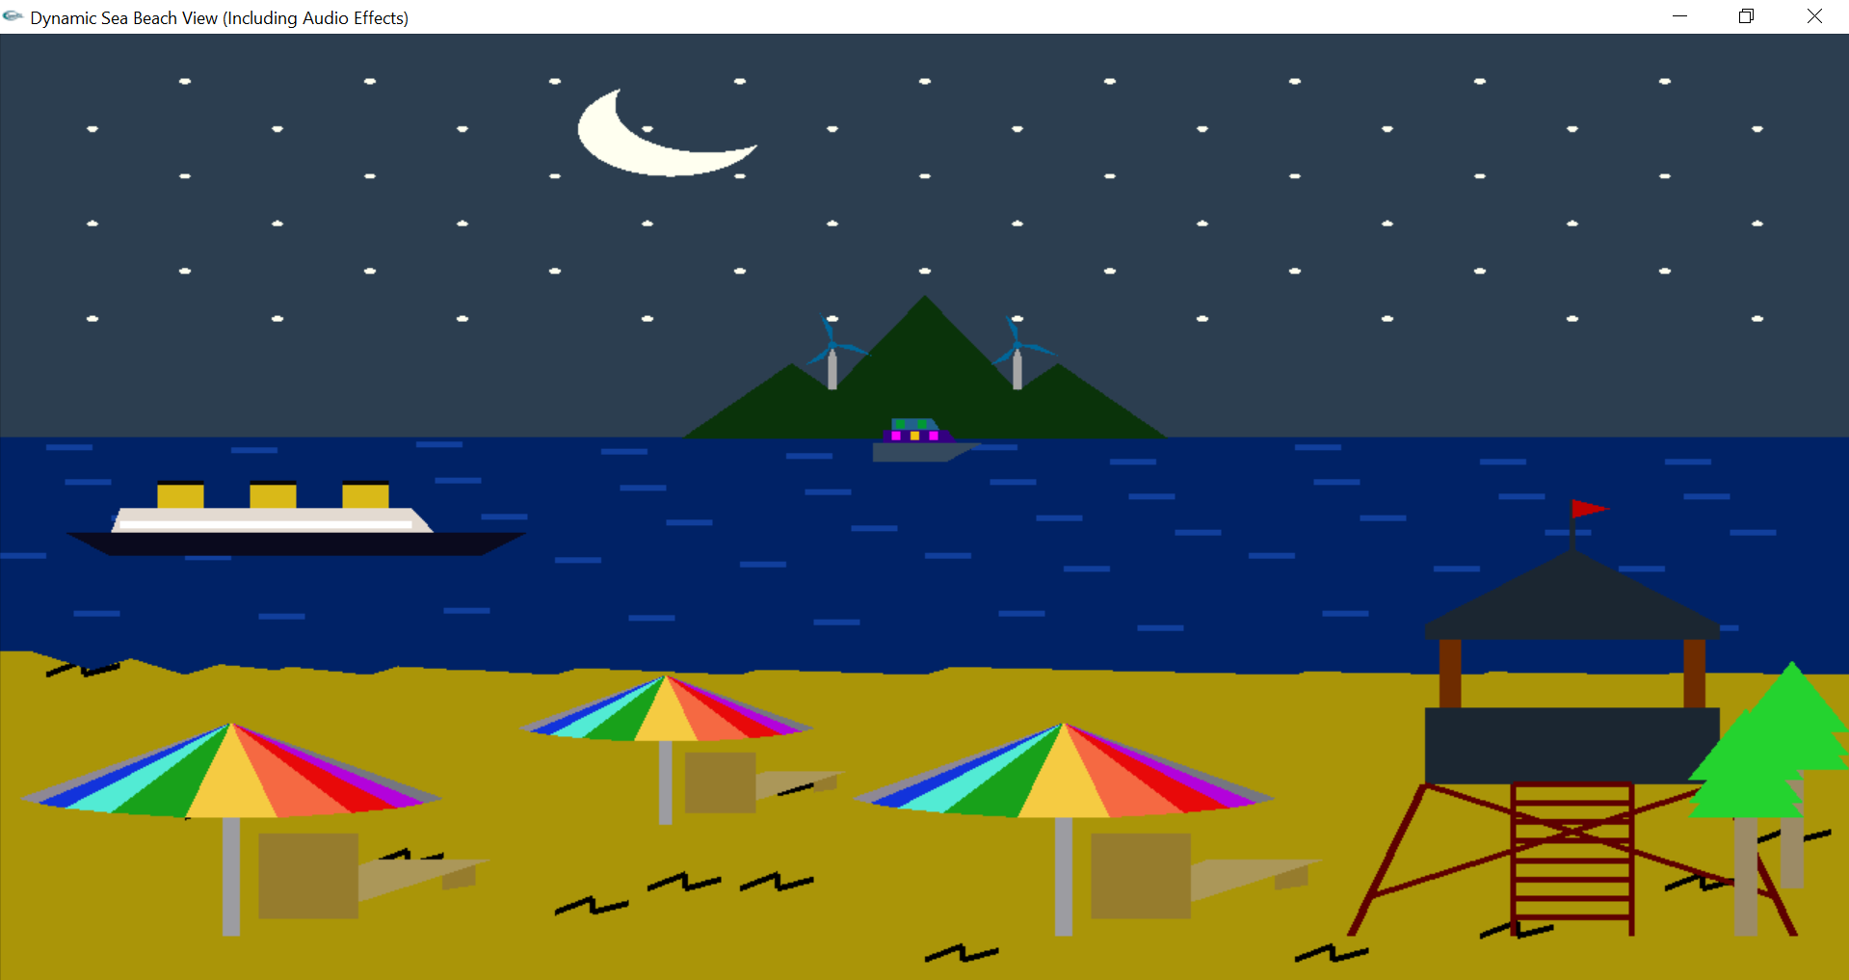

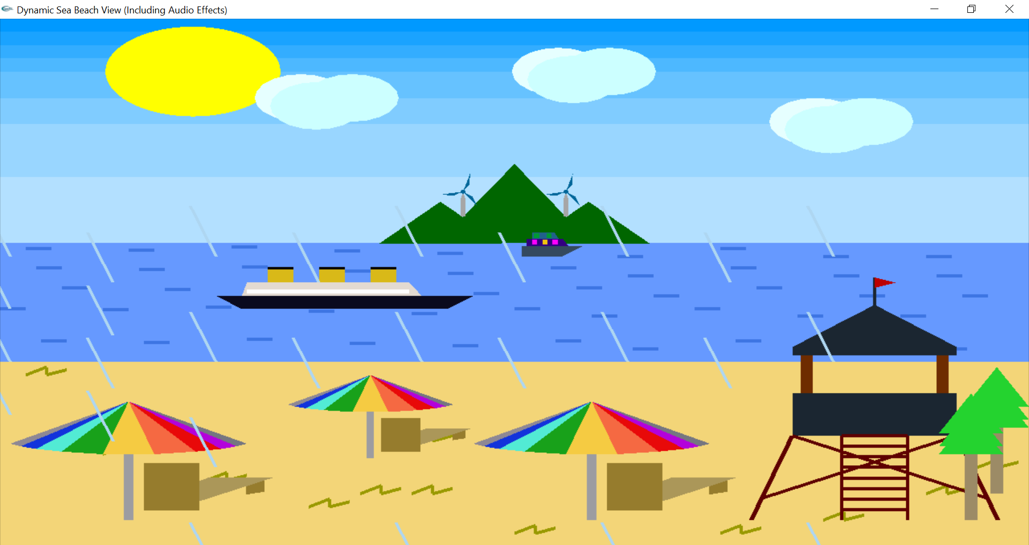
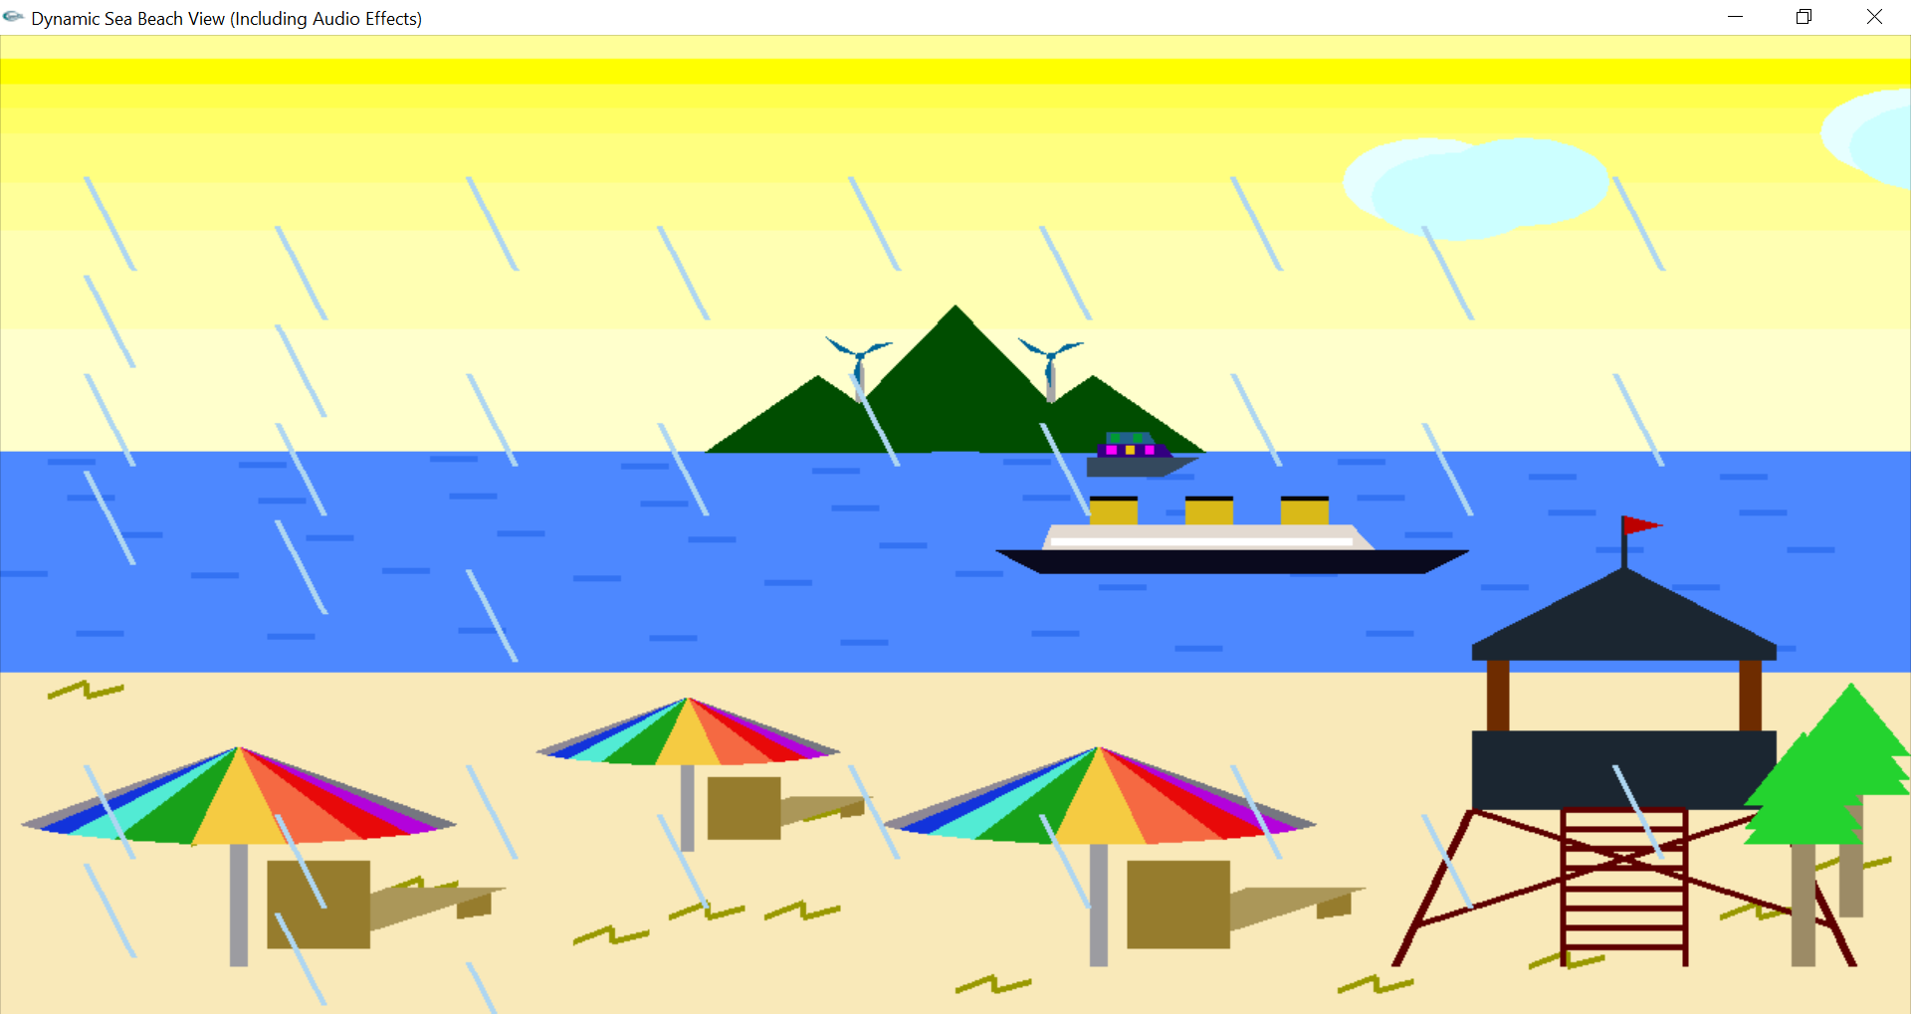
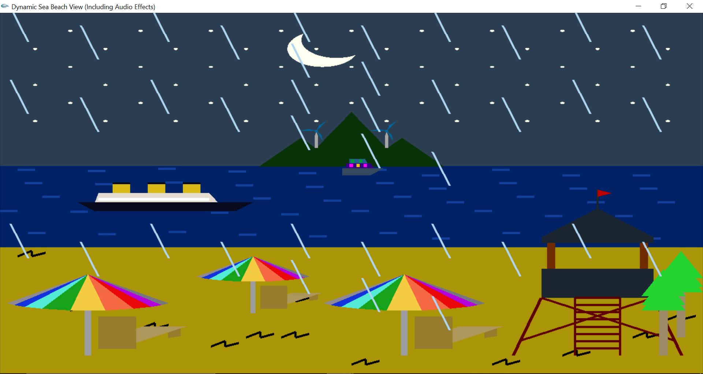
Rain Effect R Regular View D
Views

